Slide 1
Daily Incident/RITM Report

Slide 2


What is Daily Incident/RITM Report?
It is a report in which we will capture all the Incidents and RITMs from last 24 hours and send it to the relevant people

Slide 3
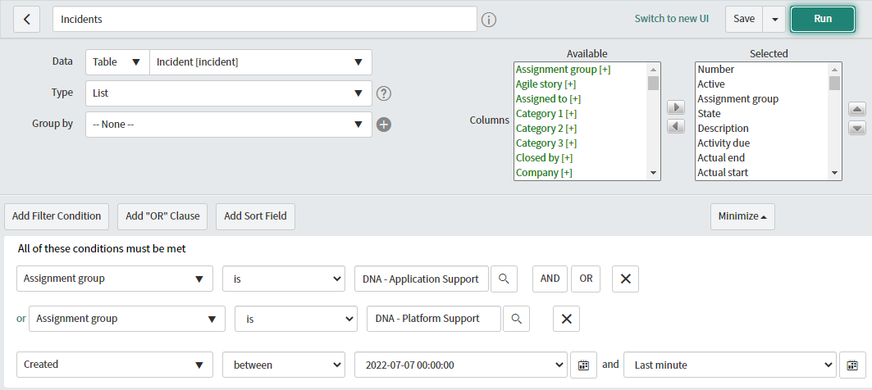
How to capture Incidents?
Capture all the Incidents from service now using report, as below picture

Slide 4
Make sure that you choose all the relevant DL's and also select the fields/columns that are relevant to you
In the last picture, as mentioned we have choose the timeframe from last 24 hours
Once after you fill all the fields, click on run on the top right corner
We will be getting the all the incidents once the report is run, we also have an option to export the data to CSV, Excel, PDF and JSON
By clicking on this icon, we will be getting an option for export

Slide 5
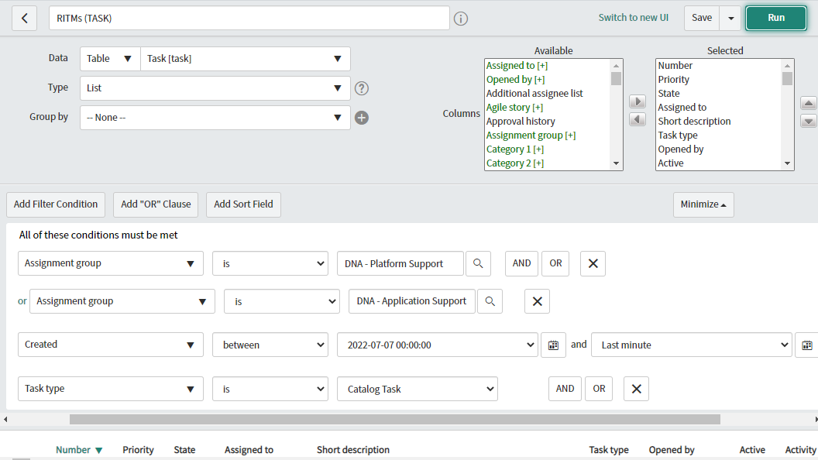
How to capture RITMs?
Capture all the RITMs from service now using report, as below picture

Slide 6
Same as Incident report, choose all the relevant columns and click on run. With this report we will be able to get all RITMs from last 24 hours
We can also export them to EXCEL or PDF, same like an incident.

Slide 7
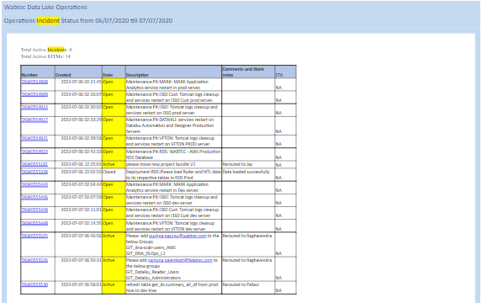
Once we get all the Incidents and RITMs, We need to prepare EXCEL combining all incidents and RITMS from last 24 hours
We need to copy the particular rows and columns from the EXCEL file and paste the same in a mail.
Below is the format of how we are sending incident/RITM report

